Slide 1
Gravitational lensing
6 - derivation of the properties of a lens
Massimo Meneghetti
AA 2017-2018

Slide 2
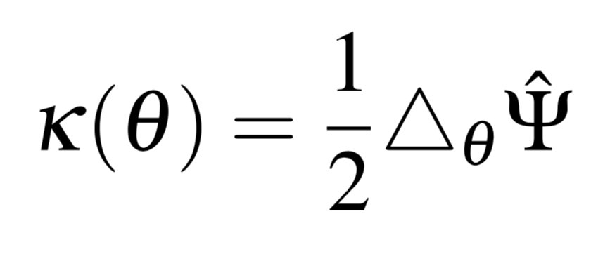
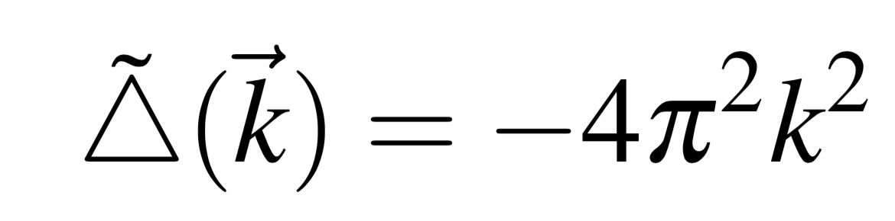
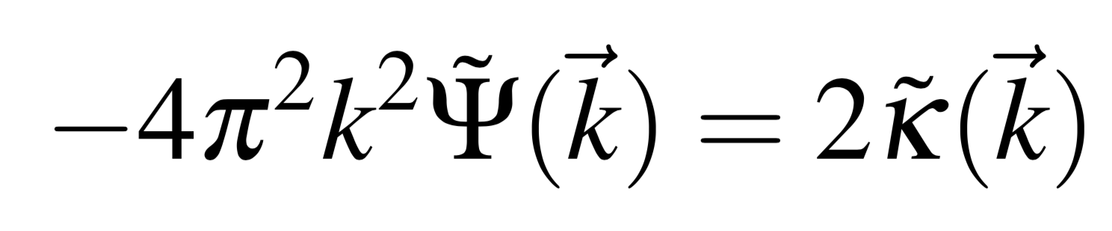
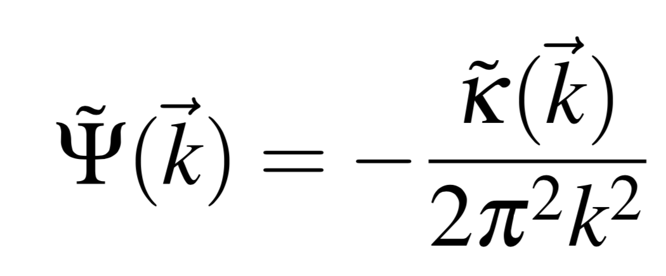
calculation of the lensing potential (algorithm)
The Laplacian of the lensing potential is twice the convergence:
The solution of this problem (Poisson equation on the plane) can be found in Fourier space:
Laplace operator in Fourier space:
Rewrite the Eq. above in Fourier space
Find the Fourier transform of the potential from the Fourier transform of the convergence

Slide 3
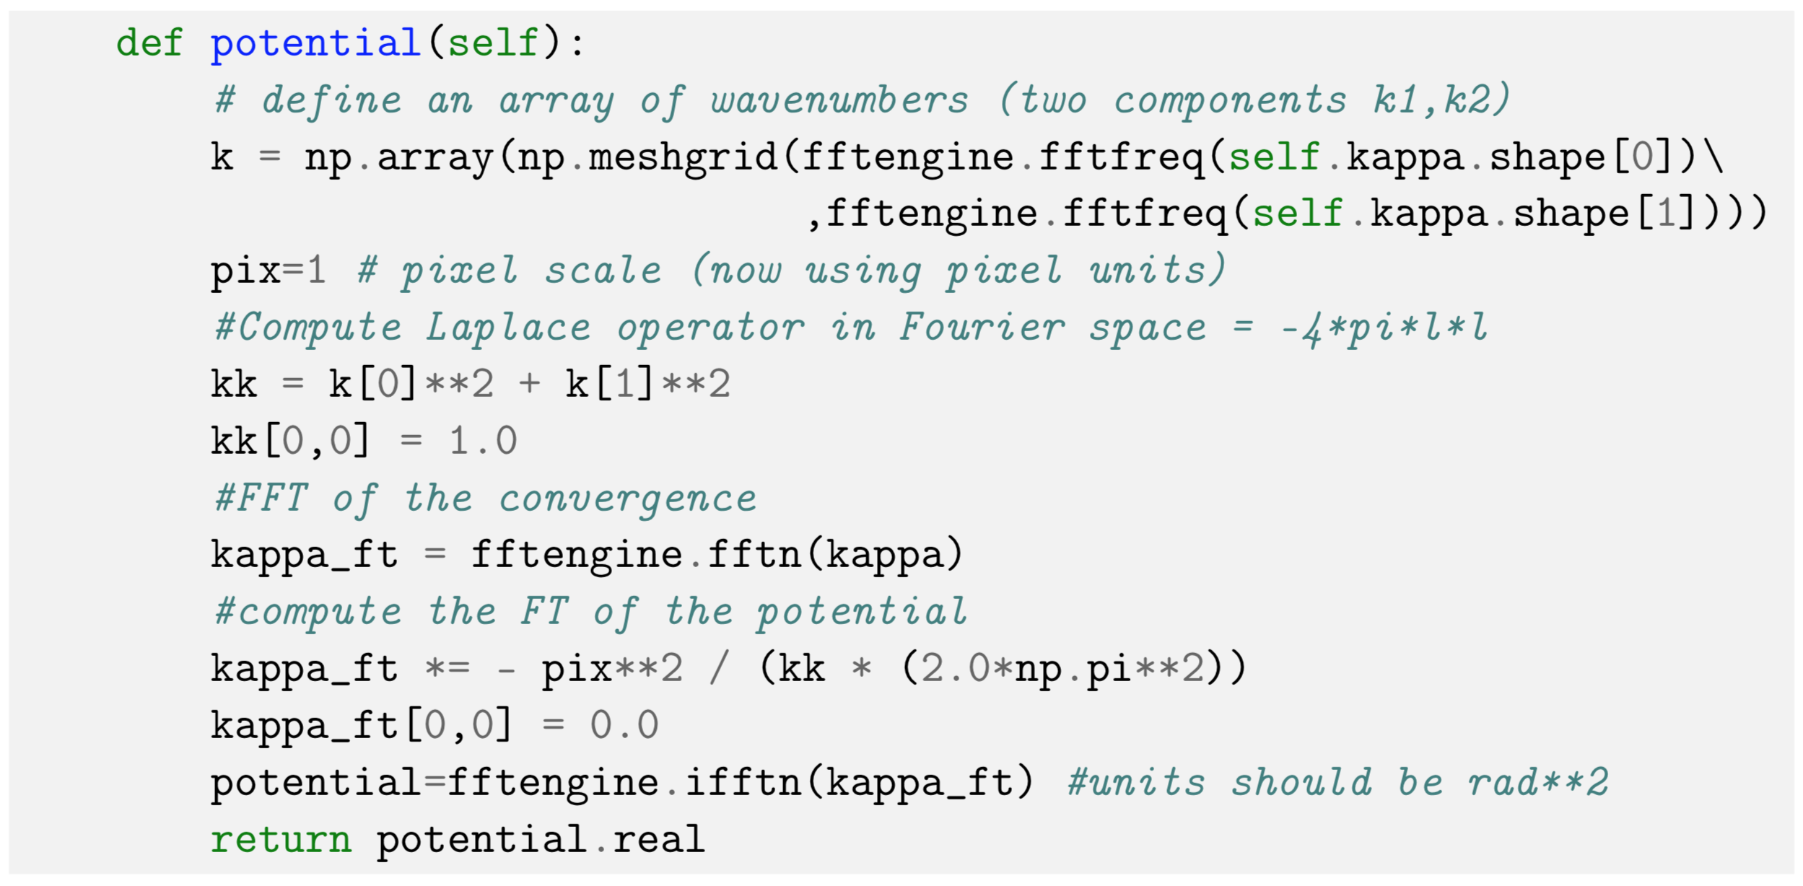
python implementation (see also notebook 5_2018)
Wave vectors from size of the convergence map
FT of the convergence
FT of the Laplacian
IFT to get the potential

Slide 4
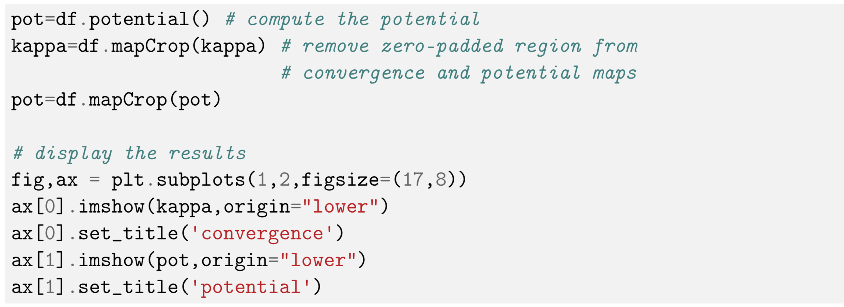
result
Apply the potential method to the deflector df from the past lesson

Slide 5
result (note the different level of smoothness)

Slide 6
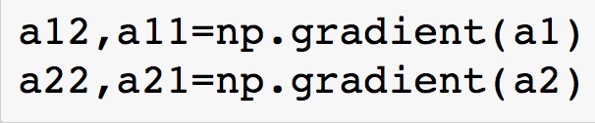
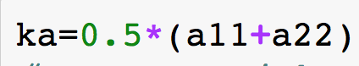
result (note the different level of smoothness)
First derivative (gradient)
Second derivative (Laplacian)

Slide 7
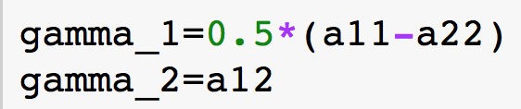
maps of the shear commonents
Note that patterns are rotated by 45 degrees

Slide 8
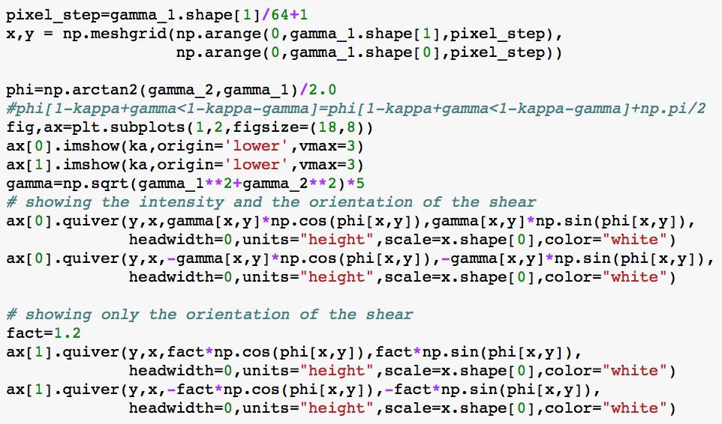
direction of distortions (first order)
phase of the shear
shear as a stick: project along x,y

Slide 9
direction of distortions (first order)
shear traces mass!
shear is strong also in between mass clumps

Slide 10
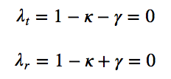
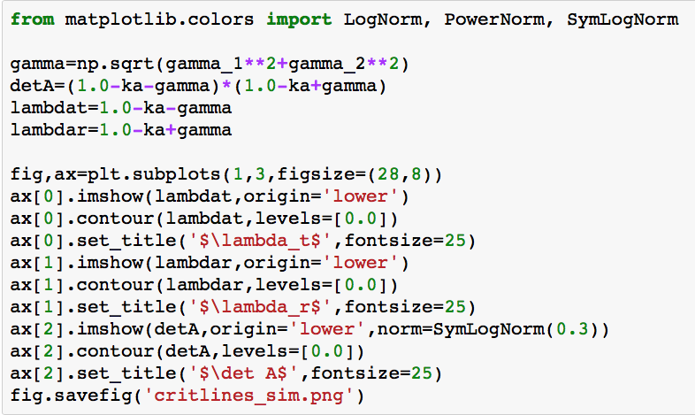
critical lines
Maps of detA and of the eigenvalues of A
0-level contours

Slide 11
critical lines
tangential
radial
both

Slide 12
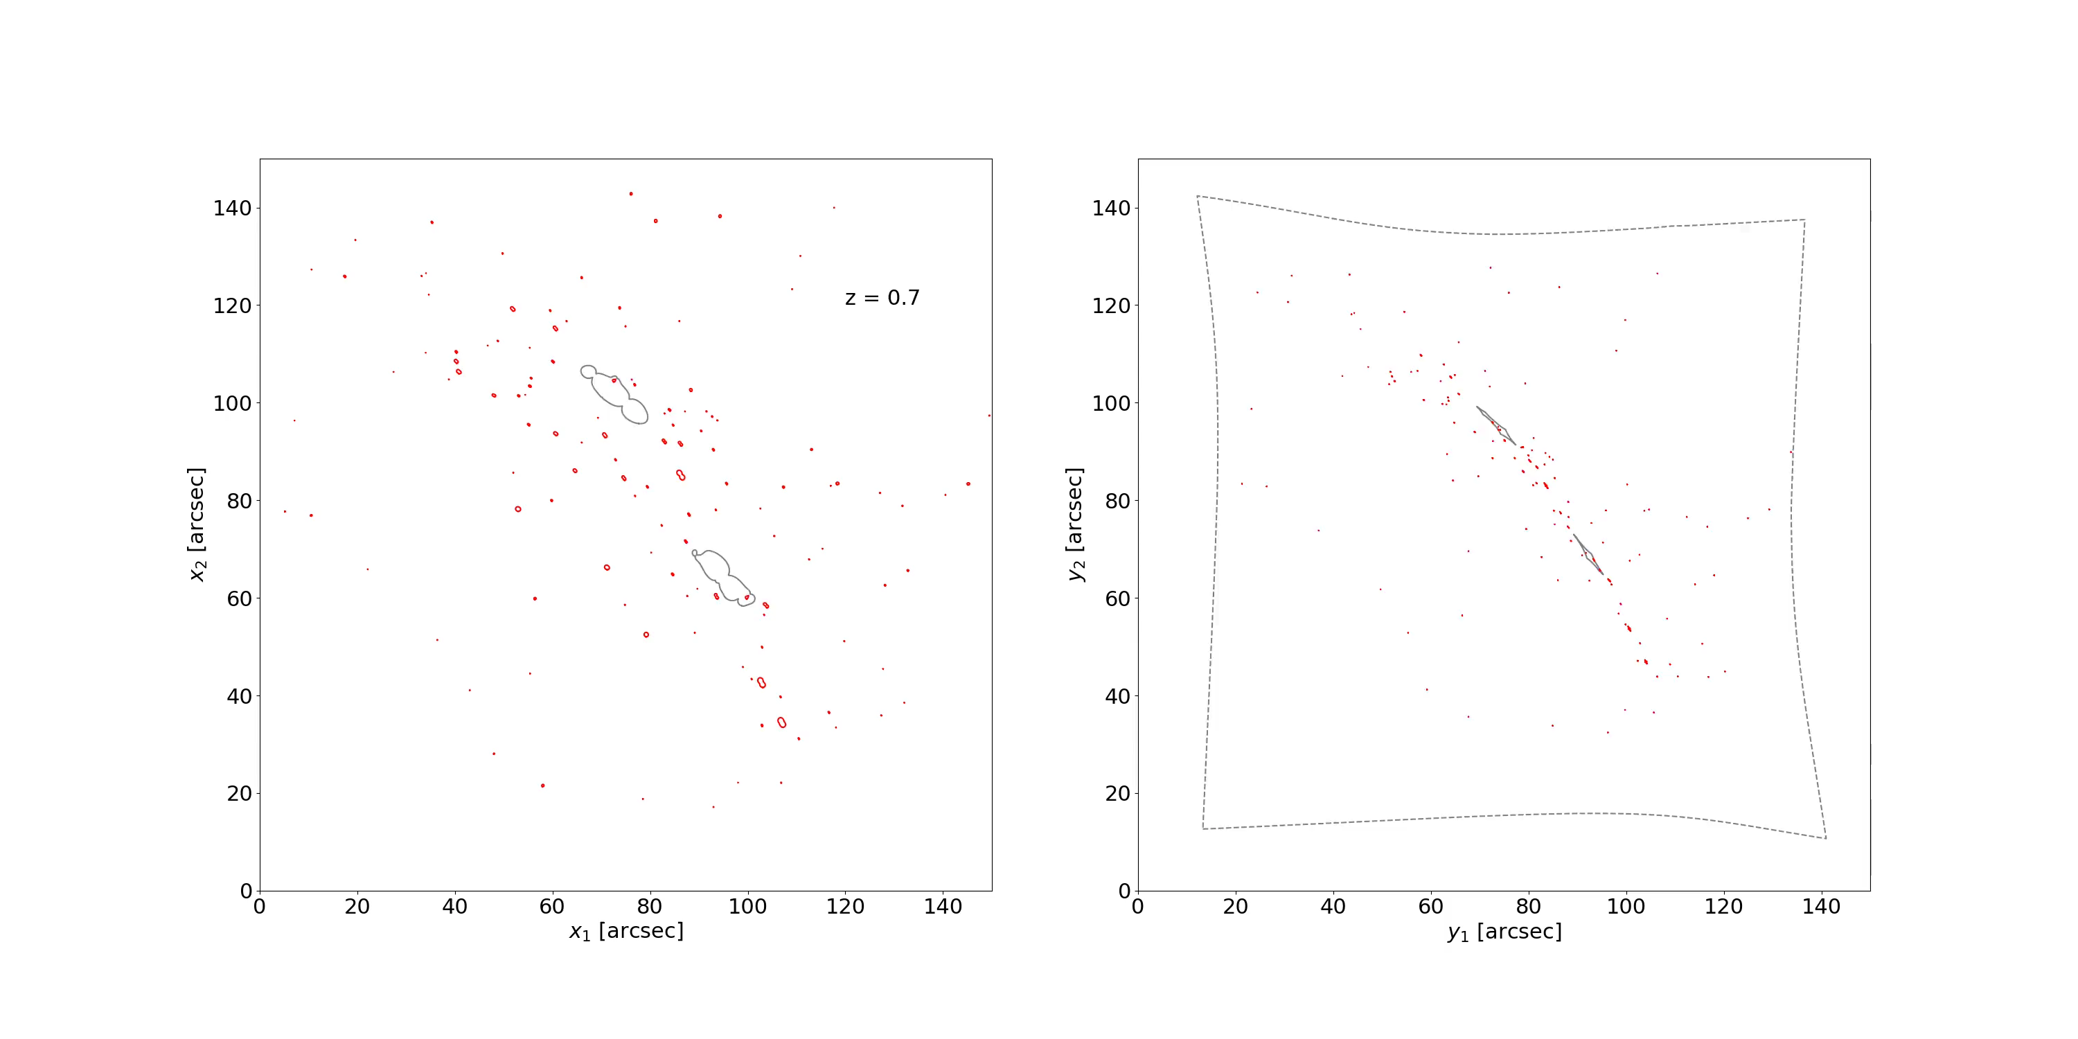
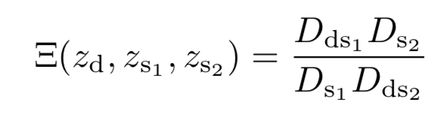
multiple images of two different sources at different redshift constrain the “family ratio”
which in turn depends on cosmological parameters (Soucail et al. 2004; Jullo et al. 2010)

Slide 13
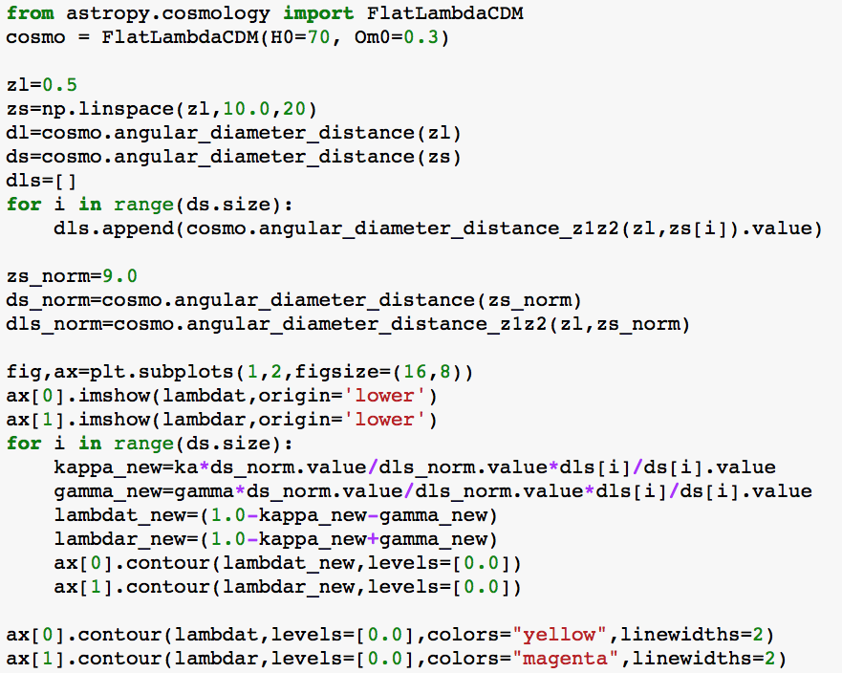
redshift dependence
cosmological model and angular diameter distances for each source redshift
Update convergence and shear for each redshift of the source

Slide 14
redshift dependence

Slide 15
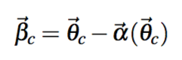
caustics
deflection angle at the positions of the critical points
points on the caustics
points on the critical lines

Slide 16
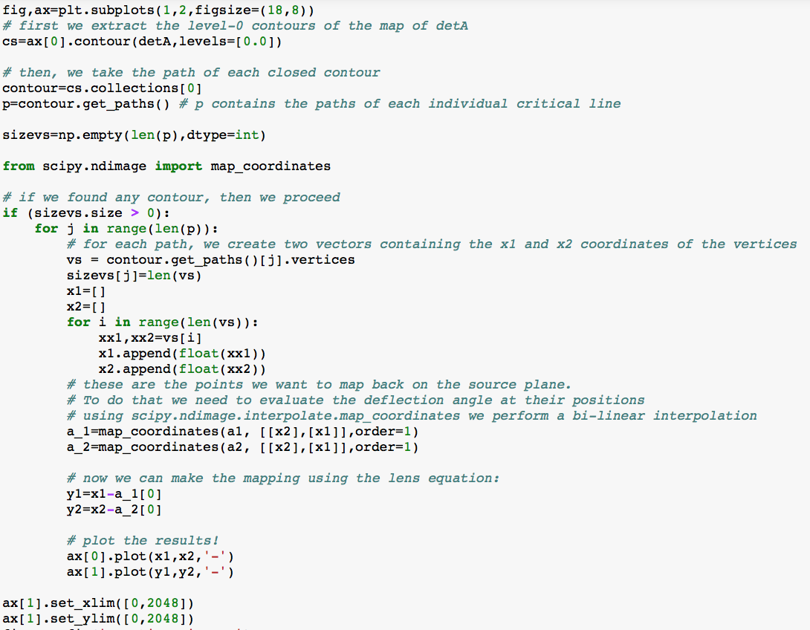
save the 0-level contours in an object and extract the path of each of them
make a list of the points in each path
calculate deflection angles at each critical point
apply lens equation

Slide 17
critical lines
caustics

Slide 18
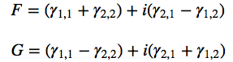
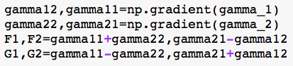
flexion

Slide 19
spin 1
spin 3

Slide 20
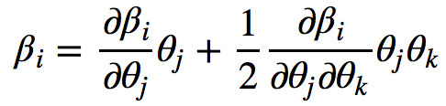
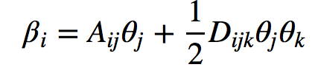
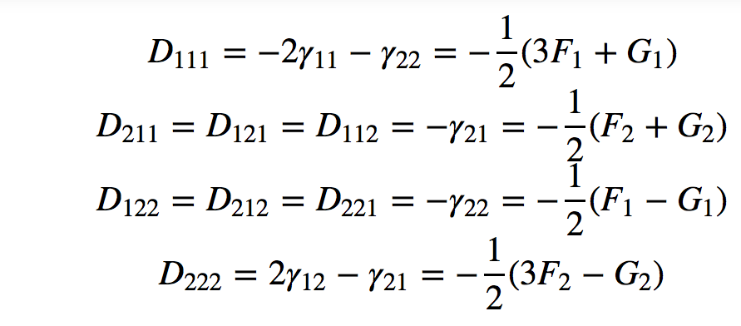
lens distortions up to 2nd order
Lens equation including 2nd order terms
Elements of Dijk

Slide 21
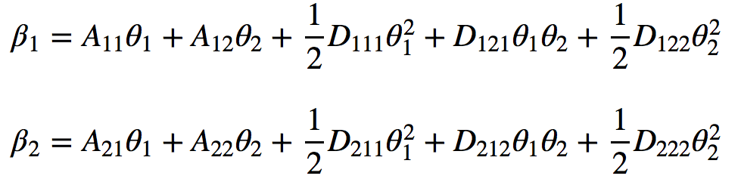
lens distortions up to 2nd order
After some math:
These equations allow us to perform ray-tracing: we can apply them to the coordinates of the points on a grid covering the lens plane and find the arrival positions of the source plane (well…only to second order approximation!)
deflection angle varies too rapidly for these rays to apply 2nd order lens equation

Slide 22
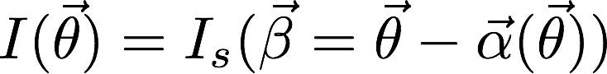
lens distortions up to 2nd order
If we place a source on the source plane, we can use this technique to reconstruct its distorted images. We make use of the conservation of the surface brightness:
source

Slide 23
shear and flexion distortions

